Slide 1




CHILDREN NEED
TO UNDERSTAND WHAT IS HAPPENING
Tips for parents, caregivers, teachers, grandparents.
What to say and how to say it

Servizio Neuropsichiatria Infantile-Ambulatorio Trauma&EMDR
Centro S.Maria al Castello –Pessano c/B
Alessia Incerti-Martina Tarantola-Flavio
Cimorelli

Slide 2
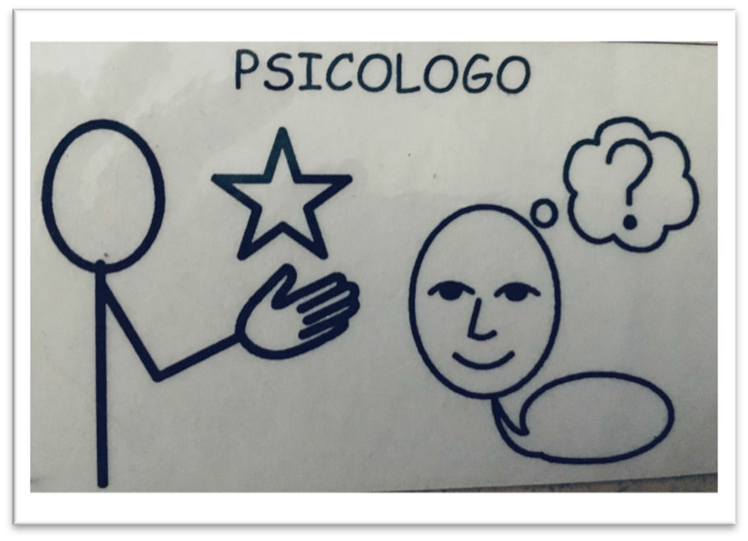
TEXT BY
 Dr. ALESSIA INCERTI
Psychologist, psychotherapist,
Trauma & EMDR Outpatient
Fondazione Don Carlo Gnocchi Clinic center - Pessano C / B- Milan Italy
 Dr. Martina Tarantola
Psychomotor therapist
Fondazione Don Carlo Gnocchi Clinic center - Pessano C / B- Milan Italy

Slide 3
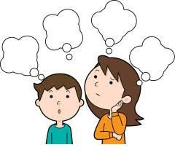
What is happening?
How to explain the situation to children that don't know or can't read.
Use AAC symbols

Slide 4
What is happening?
DEAR CHILDREN
THESE ARE
SOME
SPECIALS DAYS
YOU CANNOT GO
TO SCHOOL
YOU CANNOT GO
TO PLAY
WITH
THE
THERAPIST
WHY NOT ?

Slide 5
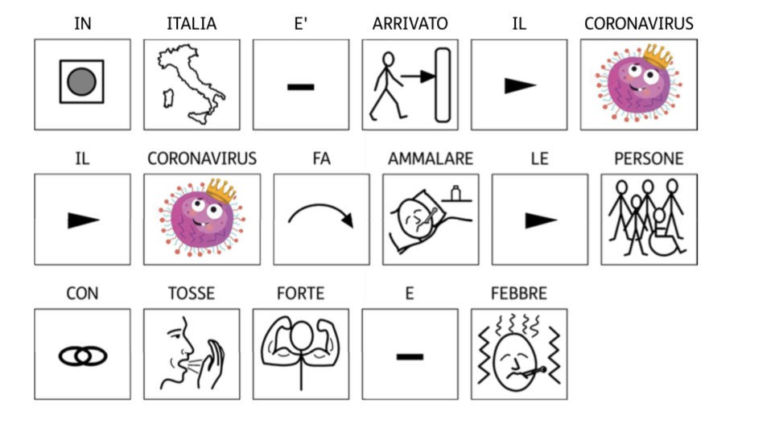
IN
ITALY
IS
COMING
THE CORONAVIRUS.
CORONAVIRUS MAKES
PEOPLE
SICK
WITH
SEVERE COUGH AND
FEVER

Slide 6
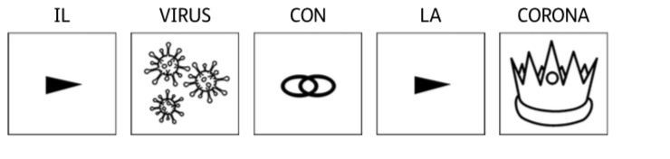
il
THE
VIRUS
HAS
THE
CROWN

Slide 7
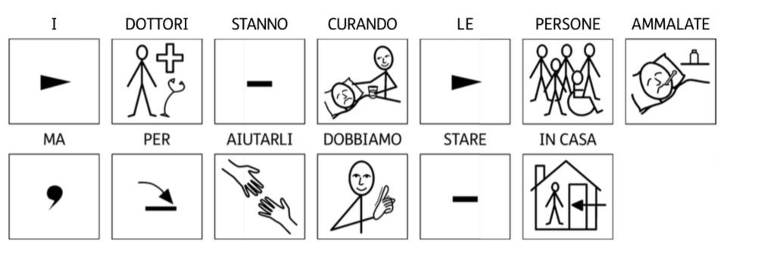
DOCTORS
ARE
TREATING
SICK PEOPLE
BUT
TO HELP THEM WE HAVE
TO
STAY AT HOME!

Slide 8
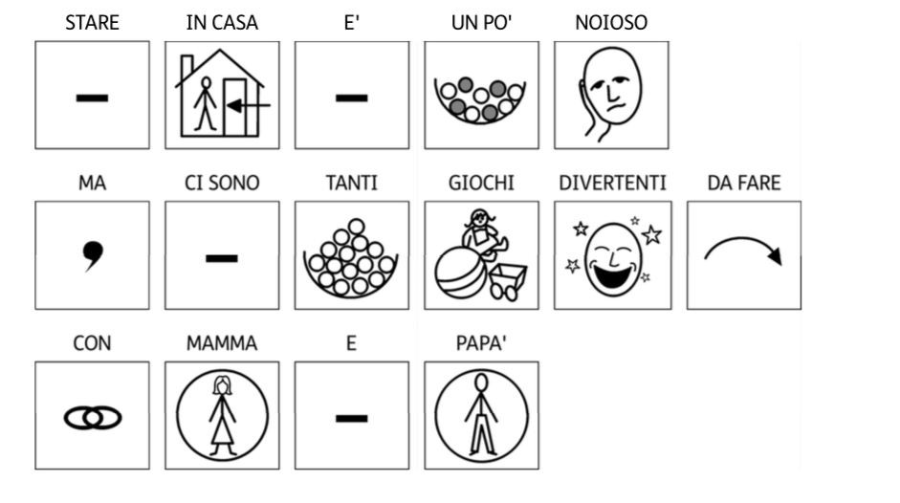
STAYING HOME
IS
A BIT BORING
BUT
THERE ARE
MANY
FUN GAMES
TO DO
WITH
MUMMY
AND
DADDY

Slide 9

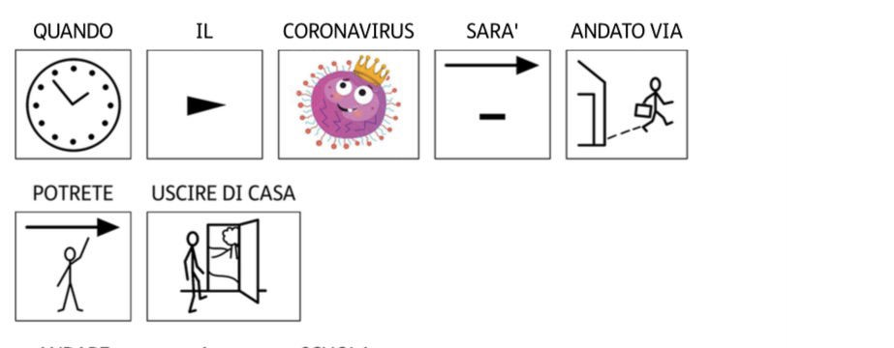
WHEN
CORONAVIRUS
IS
GONE AWAY
YOU CAN
LEAVE YOUR HOME

Slide 10
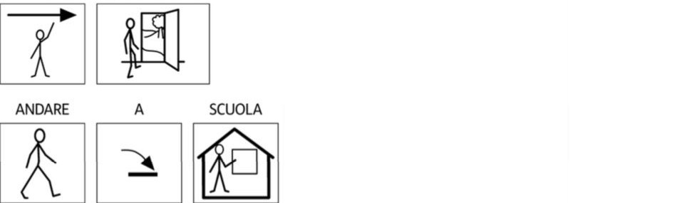
YOU CAN LEAVE YOUR HOME
GO
TO
SCHOOL

Slide 11

YOU CAN LEAVE YOUR HOME
AND
GO
TO PLAY
WITH
THE
THERAPIST

Slide 12

Dear parents and caregivers, we cannot meet you in our clinics but we want to support you.
With children, it is important not to deny what is happening, but be careful not to over-expose them.
 SOME INFORMATION FOR YOU

Slide 13
1. CHOOSE INFORMATION
 Children need CLEAR and TRUE information, filtered by age, so that they can understand.
 It is important not to expose or over-expose children to images and news that are not suitable for their level of understanding.
 Choose 1-2 moments a day to dedicate TOGETHER to check the news or look for information on the web, in order to explain what emerges, make it understandable, and reassure children through a realistic and positive-oriented focus. Explain to children that there are many people dealing with Coronavirus and highlight these aspects when they emerge on TV and on the web.

Slide 14
2. MAKE CHILDREN FEEL SAFE
 Help children continue living as children: they should play, talk about fun things, do their homework and learn new things.
 Children need to be with mom and dad and other people they trust without seeing only their frightened and alarmed faces.
Remember that children are small but they notice your emotions and state of mind.

Slide 15
2. MAKE CHILDREN FEEL SAFE
 To feel safe, a child needs to be with an adult capable of transmitting affection and mastery. Self-control first.
 Children notice adults’ inconsistencies. For example, if you say: "There is no need to be afraid", but you empty supermarkets shelves, you can cause confusion and the child will not know whether to trust you.
 Trust is essential to give security.

Slide 16
2. MAKE CHILDREN FEEL SAFE
 Remember that if you cannot calm yourself down, you cannot make your child feel safe! In these cases, seek support from another family member, the community, the network of friends or refer to clinicians.

Slide 17
DEAR TEACHERS
Reassure your students with positive messages of emotional closeness. Use the same daily greeting you would use if you were in the classroom.
 Maintain a routine even for the youngest children in kindergarden:
 Good morning and the calendar together, send pictures or your video greeting to the parents’ WhatsApp group.
 Propose creative works to do at home.
 Read a story for them.

Slide 18
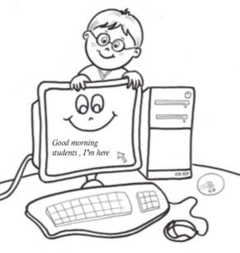
DEAR TEACHERS
 In Primary and Secondary School:
 Repeat some aspects of scholastic routine, for example give tasks and indicate the days of the week in which to perform them.
 Correct the tasks together in the virtual class.

Slide 19
DEAR TEACHERS
 In High School:
 Use the web for teaching as well. Send messages and video messages to the class group, give a timetable for the subjects.
 Assign regularly scheduled tasks and ask students to send feedback on their work.
 Correct the assignments together in the virtual class.
 Stay connected also with an individual message for each student. Maybe the teaching team can divide the students in order to maintain a privileged relationship channel.
 Remember that intense and wide-ranging emotions emerge in adolescence and there may be conflicts with the parents. Having another adult to communicate with is important!

Slide 20


Even if we are far away, do not hesitate to ask us for support for you or your children.

